Slide 1

Robot Operating system
ROS Navigation
Lecturer: Dr. Bui Ha Duc
Dept. of Mechatronics
Email: ducbh@hcmute.edu.vn

Slide 2
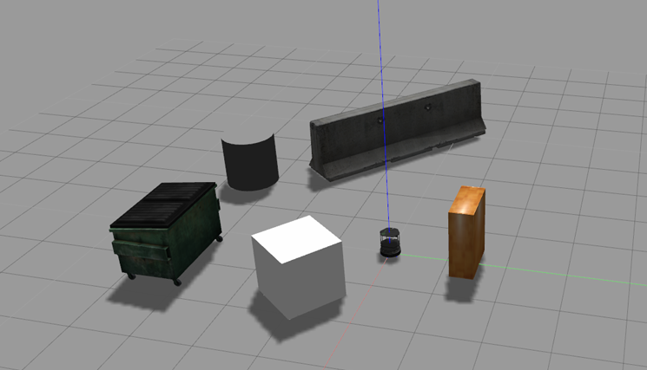
History of ROS Navigation
Purpose of navigation: Navigate robot autonomously from starting point A to final goal B given a map of the environment
To navigate a robot we need:
  A map
  A localization module
  A path planning module
These components are sufficient if:
  The map fully reflects the environment
  The environment is static
  There are no errors in the estimate
However:
  The environment (map) changes
  Thing may appear in the path of the robot
  The sensor is noise

Slide 3
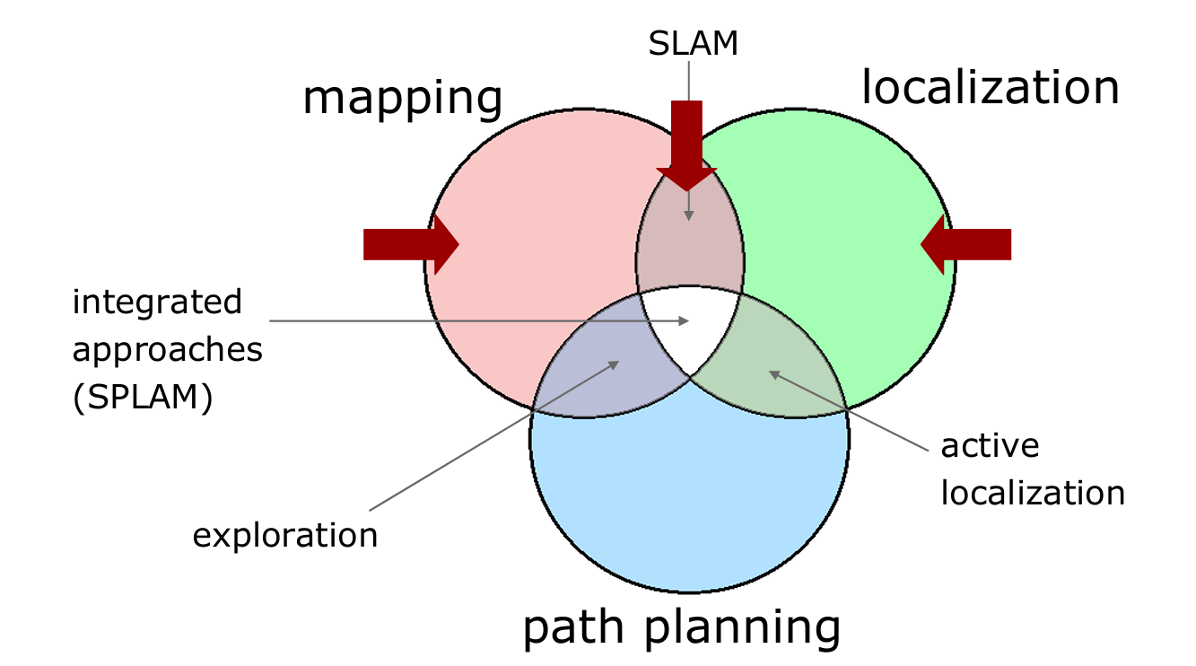
History of ROS Navigation
The original ROS Navigation Stack was born around 2008–2010
It natively supported differential-drive and holonomic robots
It’s difficult top modify without breaking the whole thing

Slide 4
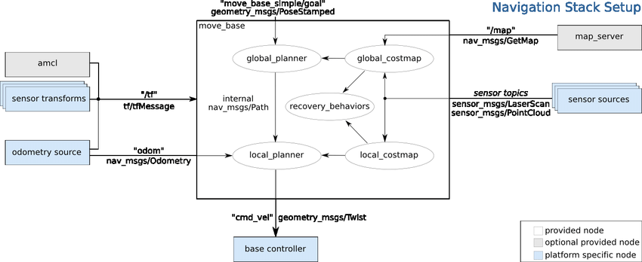
History of ROS Navigation
Planner has a layered architecture (local and global planner)
Map provided by a “Map Server”
Adaptive Monte Carlo Localization algorithm uses a particle filter to track the position of the robot
Obstacle sensing refined on-line by appropriate modules

Slide 5
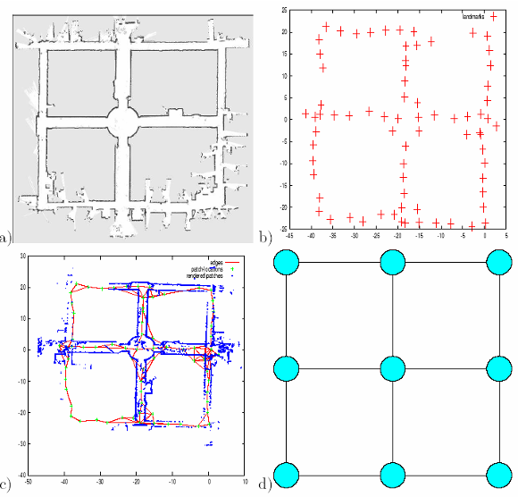
Map
A map is a representation of the environment where the robot is operating
It should contain enough information to accomplish a task of interest
Representations:
  Metric
    Occupancy Grid Based (OGM)
    Feature Based
    Hybrid
  Topological
  Hybrid
Notes:
Map files are stored as images, with a variety of common formats being supported (such as PNG, JPG, and PGM)

Slide 6
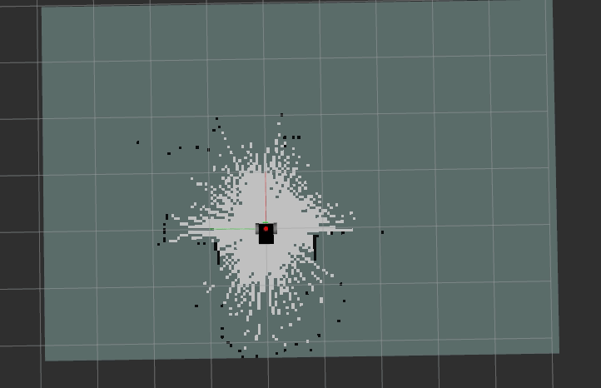
Building a Map
ROS uses GMapping, which implements a particle filter to track the robot trajectories.
To build a map you need to:
  Record a bag with /odom, /scan/ and /tf while driving the robot around in the environment it is going to operate in
  Play the bag and the gmapping-node, and then save it.

Slide 7
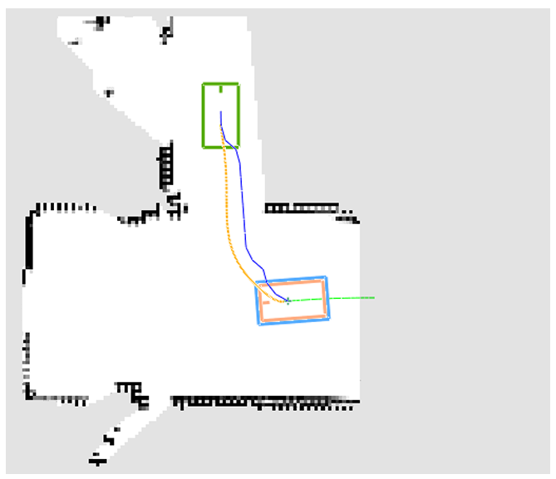
Robot Pose and Path
A metric map defines a reference frame
To operate in a map, a robot should know its position in that reference frame
A sequence of waypoints or of actions to reach a goal location in the map is a path

Slide 8
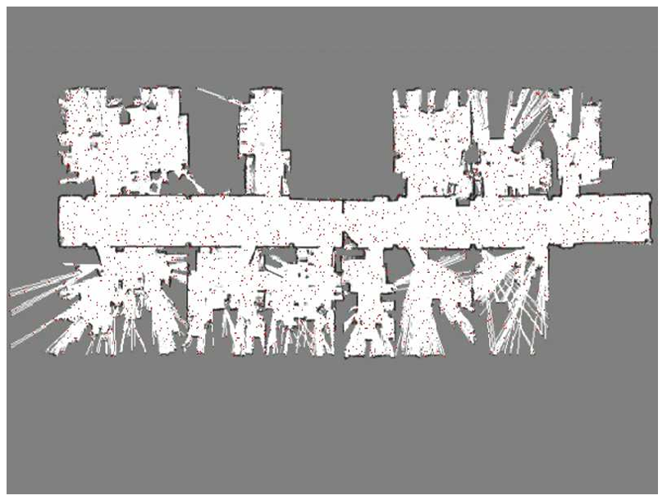
Localization
ROS implements the Adaptive Monte Carlo Localization algorithm (ACML)
ACML:
  Relies on laser scan
  Use particle filter to track robot position
https://www.youtube.com/watch?v=NrzmH_yerBU

Slide 9
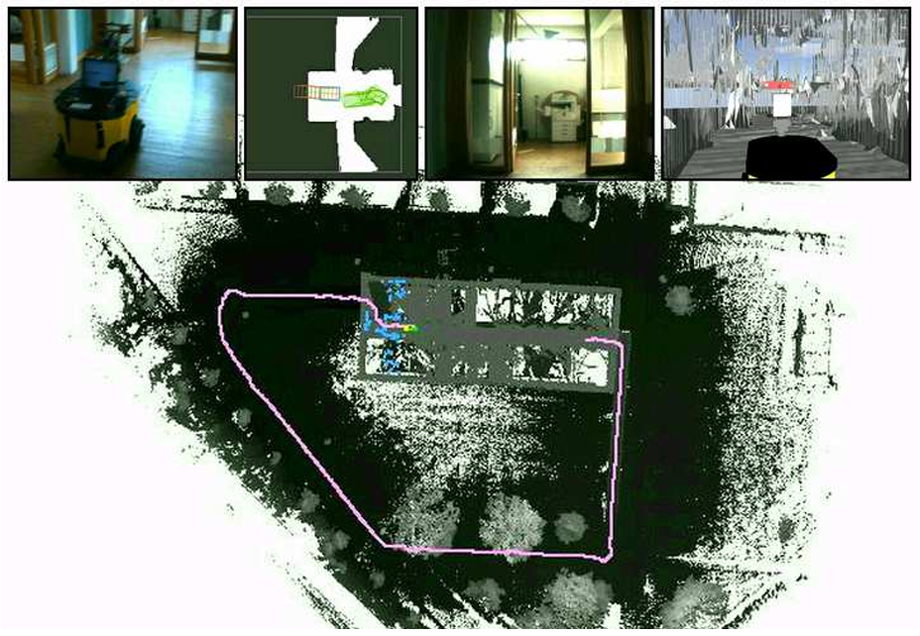
Path Planning
Determine (if it exists) a path to reach a given goal location given a localized robot and a map of traversable regions.

Slide 10
Mapping
Given a robot that has a perfect ego estimate of the position, and a sequence of measurements, determine the map of the environment.
A perfect estimate of the robot pose is usually not available.
Instead we solve a more complex problem: Simultaneous Localization and Mapping (SLAM).
SLAM= Simultaneous Localization and Mapping
Estimate:
  the map of the environment
  the trajectory of a moving device
using a sequence of sensor measurements.

Slide 11
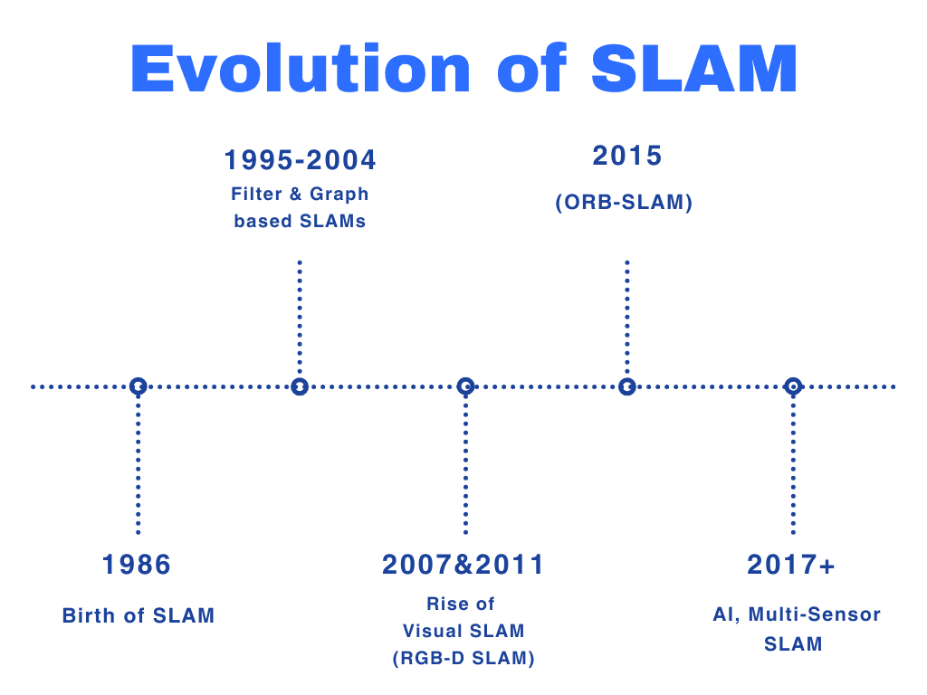

Slide 12
Navigation 2
Released in 2018
Nav2 is a complete rewrite designed to leverage the modern capabilities of ROS
  Architecture: From Monolithic to Modular
  move_base → Nav2 Servers
  Logic: From Finite State Machine (FSM) to Behavior Trees (BT)
  Complex mission logic can be defined in a simple XML file without recompiling code
  Lifecycle nodes for systematic launch
  Every major component in Nav2 has states like unconfigured, inactive, active and finalized
Notes:
Navigation is split into independent Action Servers (Planner, Controller, Smoother, Behavior Tree). Each server is a separate node, making the system more stable and easier to debug or replace specific components

Slide 13
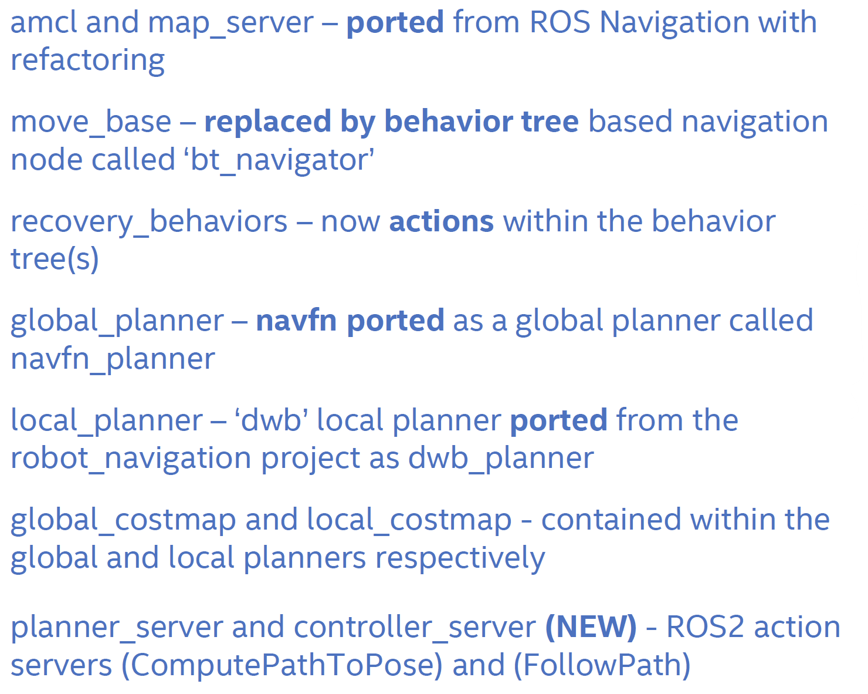
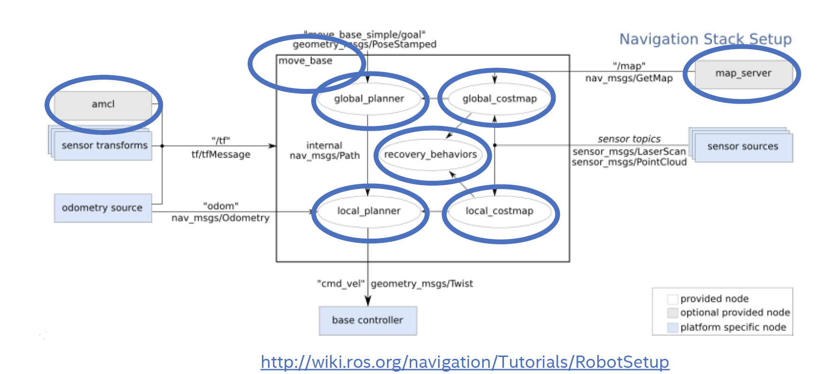
Nav2 vs Nav

Slide 14
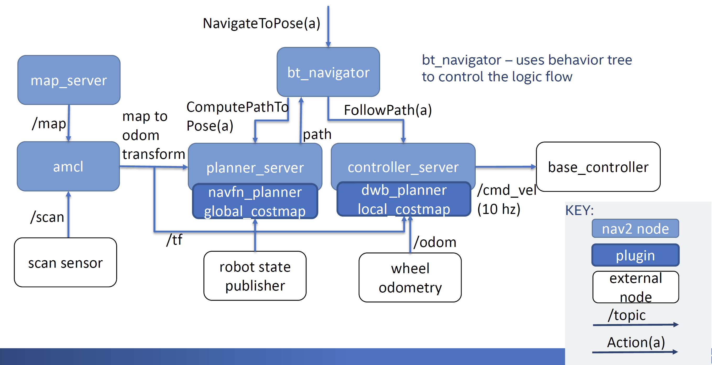
Nav2 achitecture

Slide 15
Behaviour Tree
Behavior Trees enable complex behaviors with less code and more modularity, making them easier to maintain and extend, compared to traditional state machines.
https://www.behaviortree.dev/

Slide 16
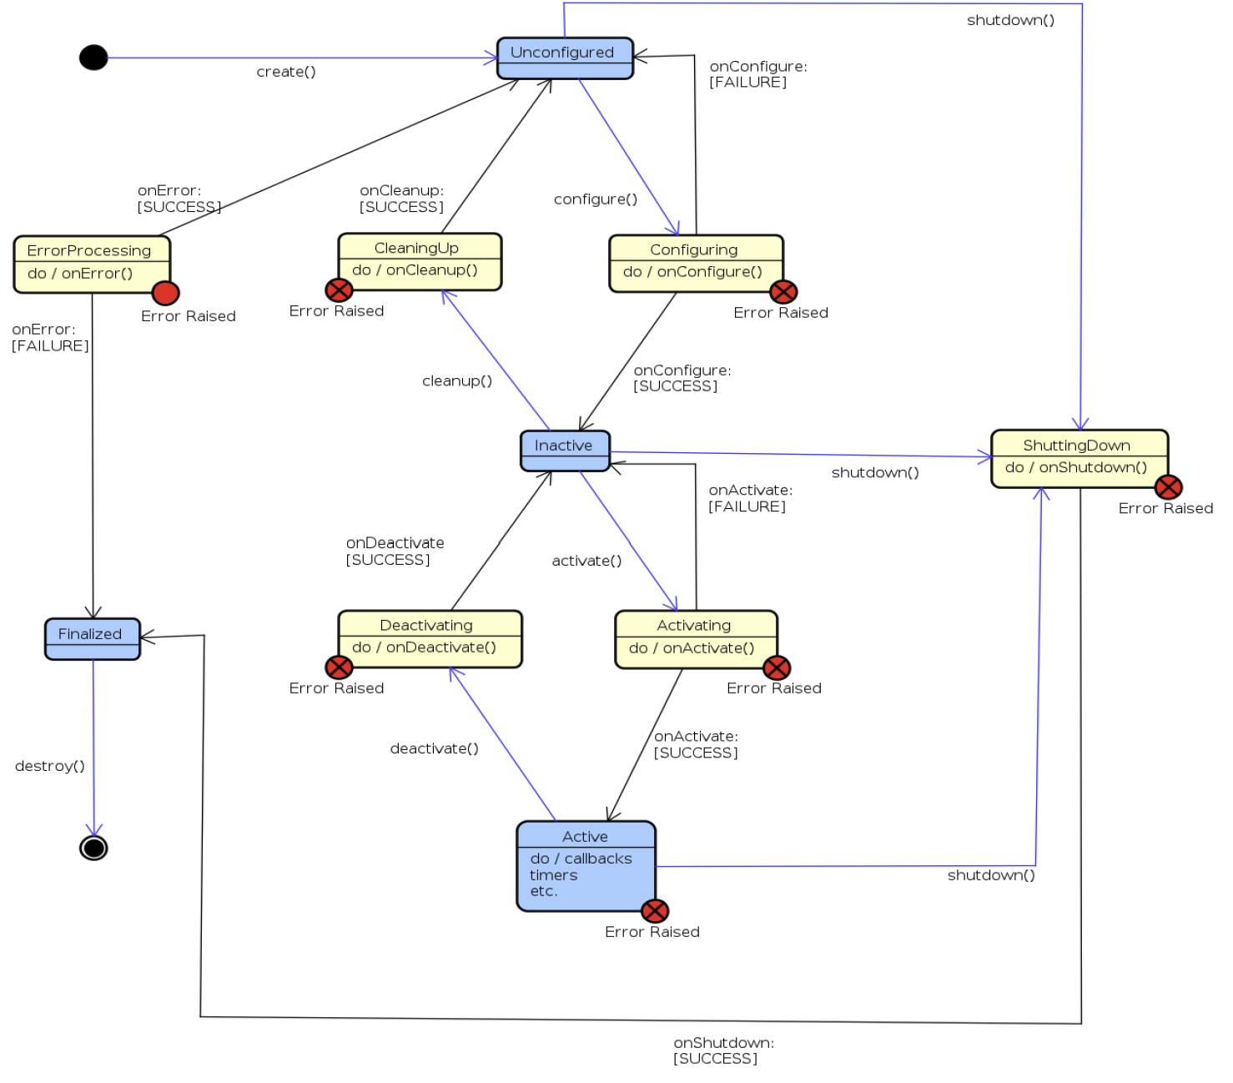
ROS2 Lifecycle nodes
States:
Unconfigured= created or new
Inactive = ready to work
Active = doing real work
Finalized = ready to destroy
States are controlled through ‘change_state’ service

Slide 17
Nav2 Plugin interface
The ‘nav2_core’ package contains abstract interfaces for plugins
Global Planner – global_planner.hpp
Local Planner – local_planner.hpp
Recovery behaviors – recovery.hpp
Goal checker – goal_checker.hpp
Exceptions – exceptions.hpp

